Slide 1
Angular JS
UNIT-5

Slide 2
What is Angular JS?
AngularJS is an open source Model-View-Controller framework which is similar to the JavaScript framework.
Angular JS is probably one of the most popular modern day web frameworks available today. This framework is used for developing mostly Single Page applications. This framework has been developed by a group of developers from Google itself.

Slide 3
Need of angular JS
It is used to minimize the number of post back events done to server to reload page on browser.
It minimizes the number of round trips of traditional web programing model.
It is used to design singe page application project sing MVC framework architecture.

Slide 4
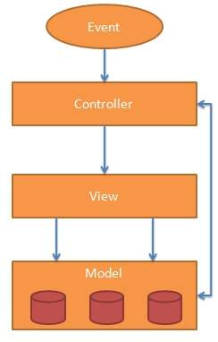
Angular JS MVC architecture

Slide 5
Angular JS MVC architecture
Model View Controller or MVC as it is popularly called, is a software design pattern for developing web applications. A Model View Controller pattern is made up of the following three parts −
Model − It is the lowest level of the pattern responsible for maintaining data.
View − It is responsible for displaying all or a portion of the data to the user.
Controller − It is a software Code that controls the interactions between the Model and View.

Slide 6
Angular JS MVC architecture
MVC is popular because it isolates the application logic from the user interface layer and supports separation of concerns. The controller receives all requests for the application and then works with the model to prepare any data needed by the view. The view then uses the data prepared by the controller to generate a final presentable response. The MVC abstraction can be graphically represented as follows.

Slide 7
Architecture of Angular JS
The Model
The model is responsible for managing application data. It responds to the request from view and to the instructions from controller to update itself.
The View
A presentation of data in a particular format, triggered by the controller's decision to present the data. They are script-based template systems such as JSP, ASP, PHP and very easy to integrate with AJAX technology.
The Controller
The controller responds to user input and performs interactions on the data model objects. The controller receives input, validates it, and then performs business operations that modify the state of the data model.

Slide 8
Angular JS
AngularJS is a JavaScript framework. It can be added to an HTML page with a <script> tag.
AngularJS extends HTML attributes with Directives, and binds data to HTML with Expressions.

Slide 9
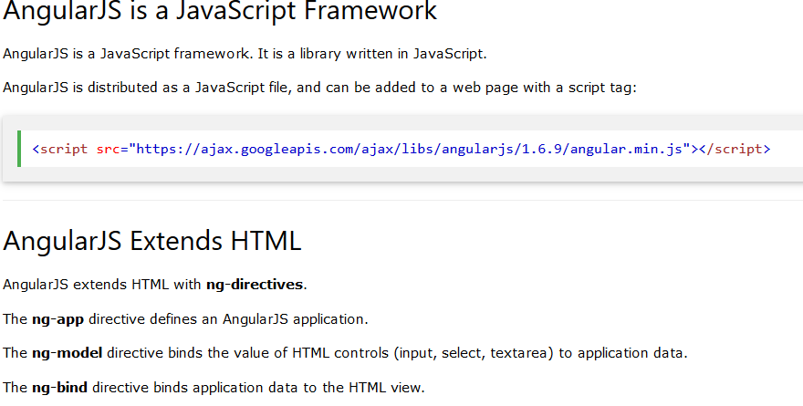

Slide 10
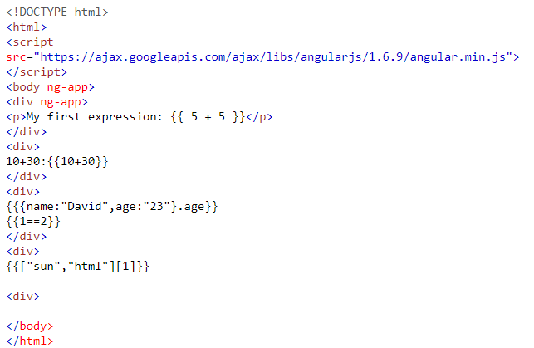
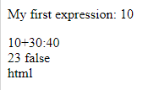
Simple Application of Angular JS
Output

Slide 11
Angular JS Features
Data-binding: Automatic synchronization of data between model and view components. When the model changes it will automatically reflect on view and vice versa. DOM manipulation is easy because of data binding.
Scope: Scope is an object that refers to the application model. Scope act as a bond between controller and view.
Controller: Javascript functions are bound to a particular scope and view is bound to a particular controller. Every view needs to bind to a particular controller.

Slide 12
Angular JS Features
Directives: Directives are one of the best features of the AngularJS. We can create custom HTML tags and provide custom behavior to tags. ng-model, ng-app, ng-hide are the example of angular is built in directives.
Templates: These are the rendered view with information from the controller and model. These can be a single file or multiple views in one page using “partials”.
Dependency Injection: AngularJS has support built-in dependency injection. It helps the developer to reuse components. We can create our module and inject into our app.

Slide 13
Angular JS Component
Components:
The AngularJS framework can be divided into following three major parts:
ng-app: This directive is used to start an angular application.
ng-model: Binds the values to HTML input controls or HTML tags.
ng-bind: This directive is used to binds the data to html tags.

Slide 14
Angular JS Expressions
AngularJS expressions can be written inside double braces: {{ expression }}.
AngularJS expressions can also be written inside a directive: ng-bind="expression".
AngularJS will resolve the expression, and return the result exactly where the expression is written.
AngularJS expressions are much like JavaScript expressions: They can contain literals, operators, and variables.
Example {{ 5 + 5 }} or {{ firstName + " " + lastName }

Slide 15
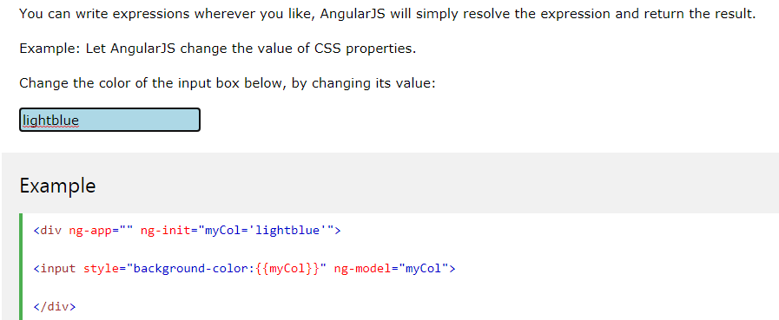
Angular Expression

Slide 16
Angular JS Directives
Following are the directives of angular JS
ng-app
ng-init
ng-model
ng-bind
ng-controller

Slide 17
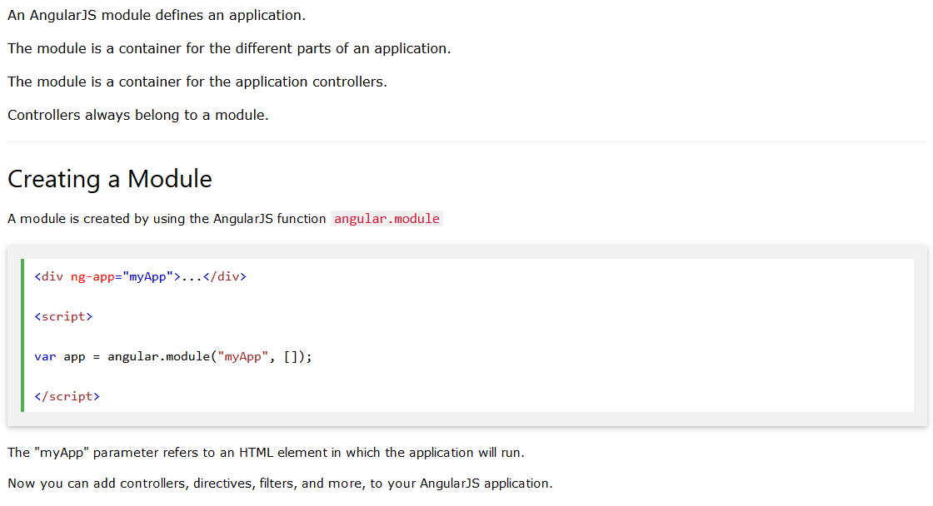
Angular JS Module

Slide 18
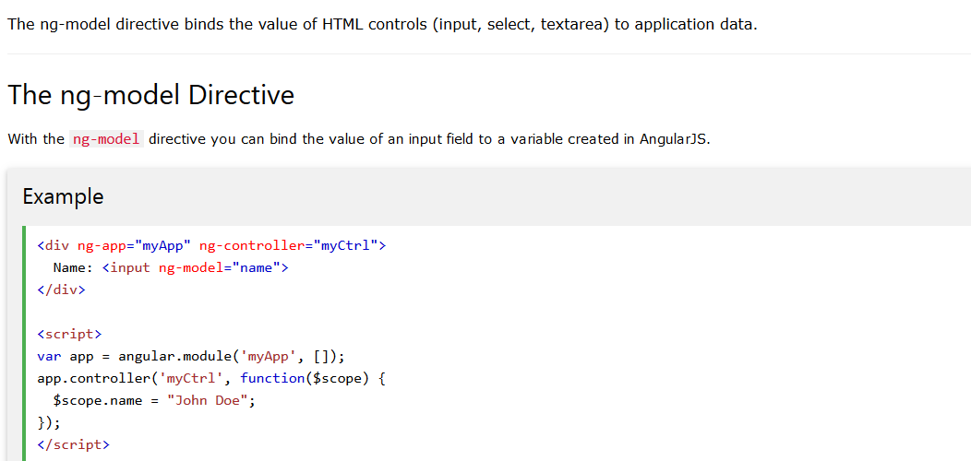
Ng-model

Slide 19
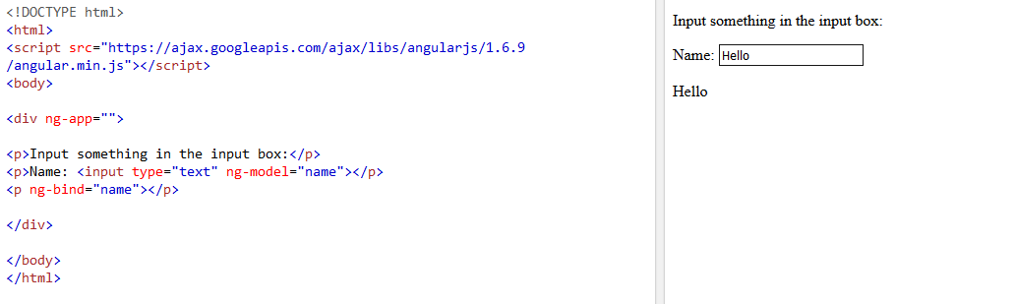
Example ng-bind

Slide 20
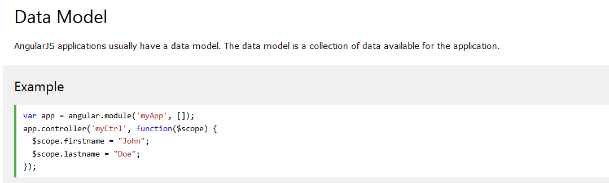
Angular JS Data Binding
Data binding in AngularJS is the synchronization between the model and the view.

Slide 21
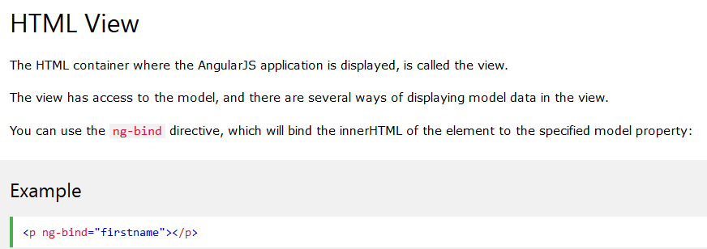
Angular JS Data Binding

Slide 22
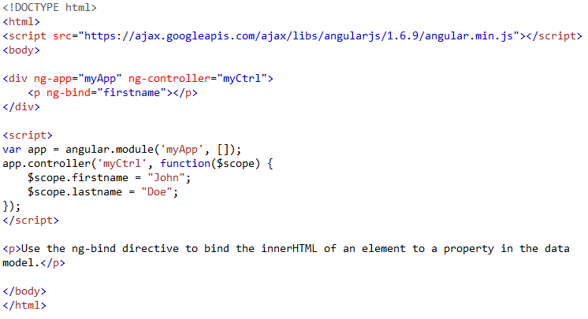
Example of ng-bind
Output
John

Slide 23
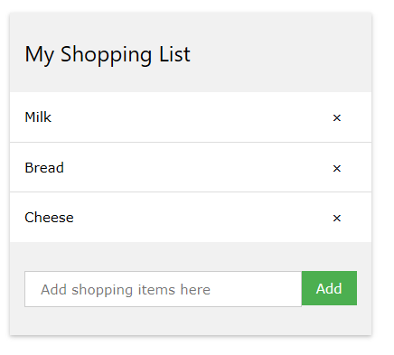
Design Angular JS Application for Shopping Cart List

Slide 24
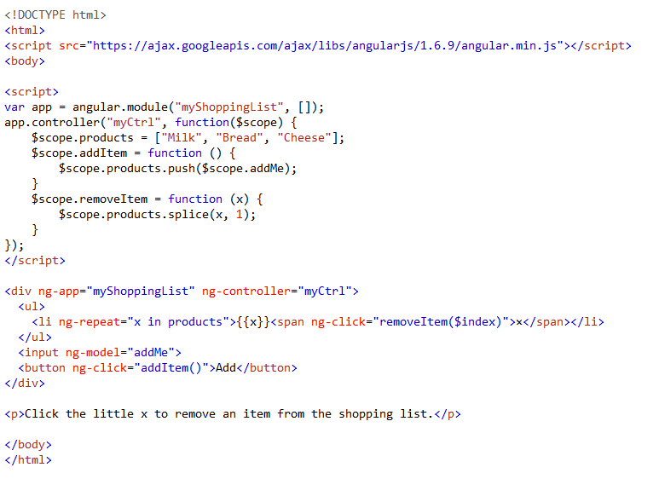
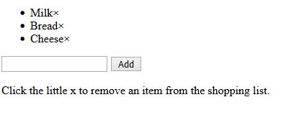
Creating Shopping Cart Application using ng-repeat

